Slide 1
Latin America: an overview of organizations that pressure Parliaments towards more transparency
July 6th, Paris, France

Slide 2
ARGENTINA
July 6th, Paris, France

Slide 3
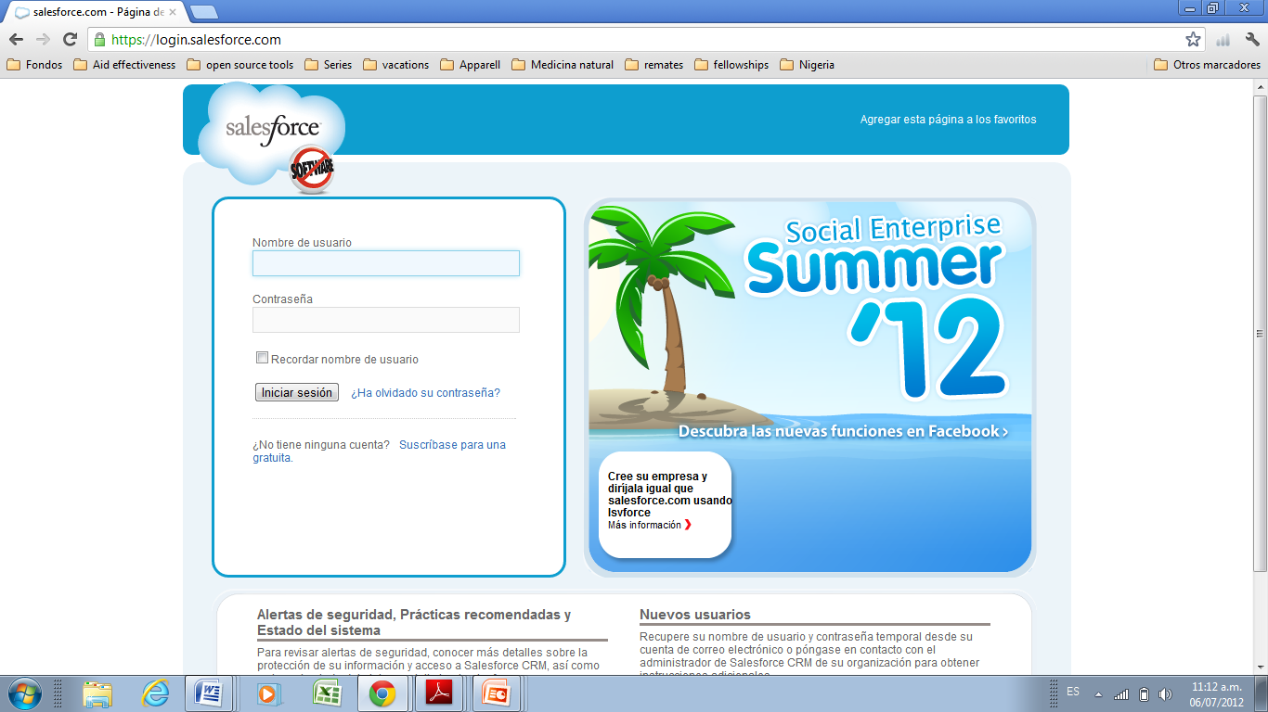

Slide 4
Salesforce
Collected data from MPs since 1999
Correspondence
Telephone calls and emails
Bills
Hansard
Social networks
Minutes in meetings
Financial statements from 2001

Slide 5
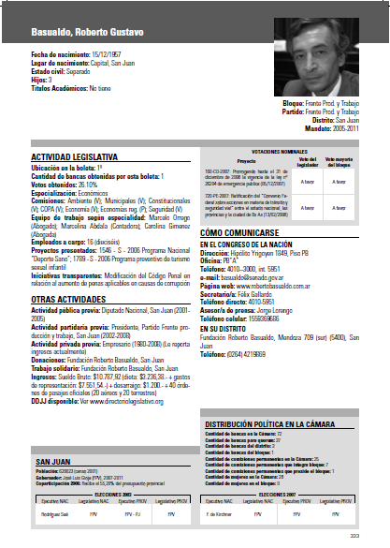

Slide 6
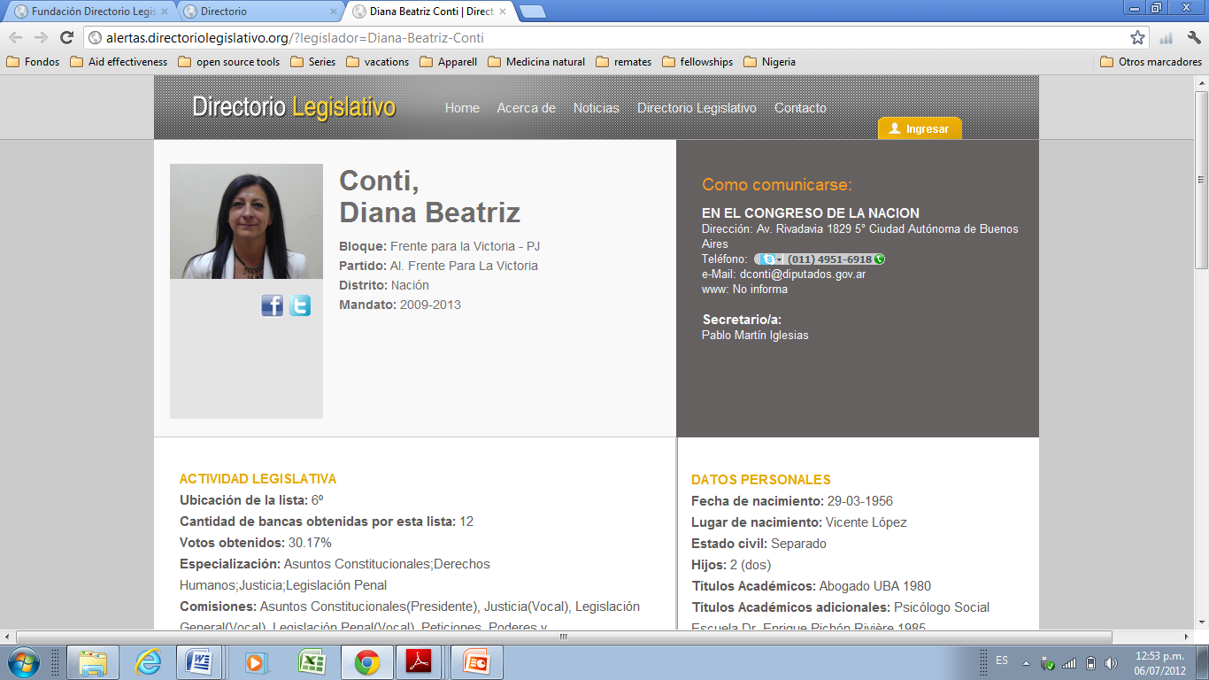
July 6th, Paris, France

Slide 7
México
July 6th, Paris, France

Slide 8
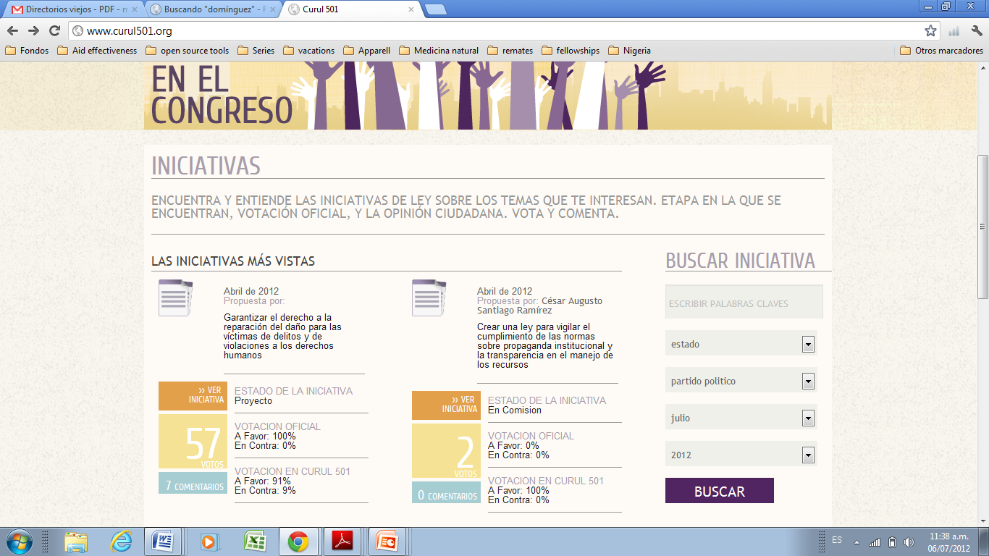

Slide 9
Perú
July 6th, Paris, France

Slide 10
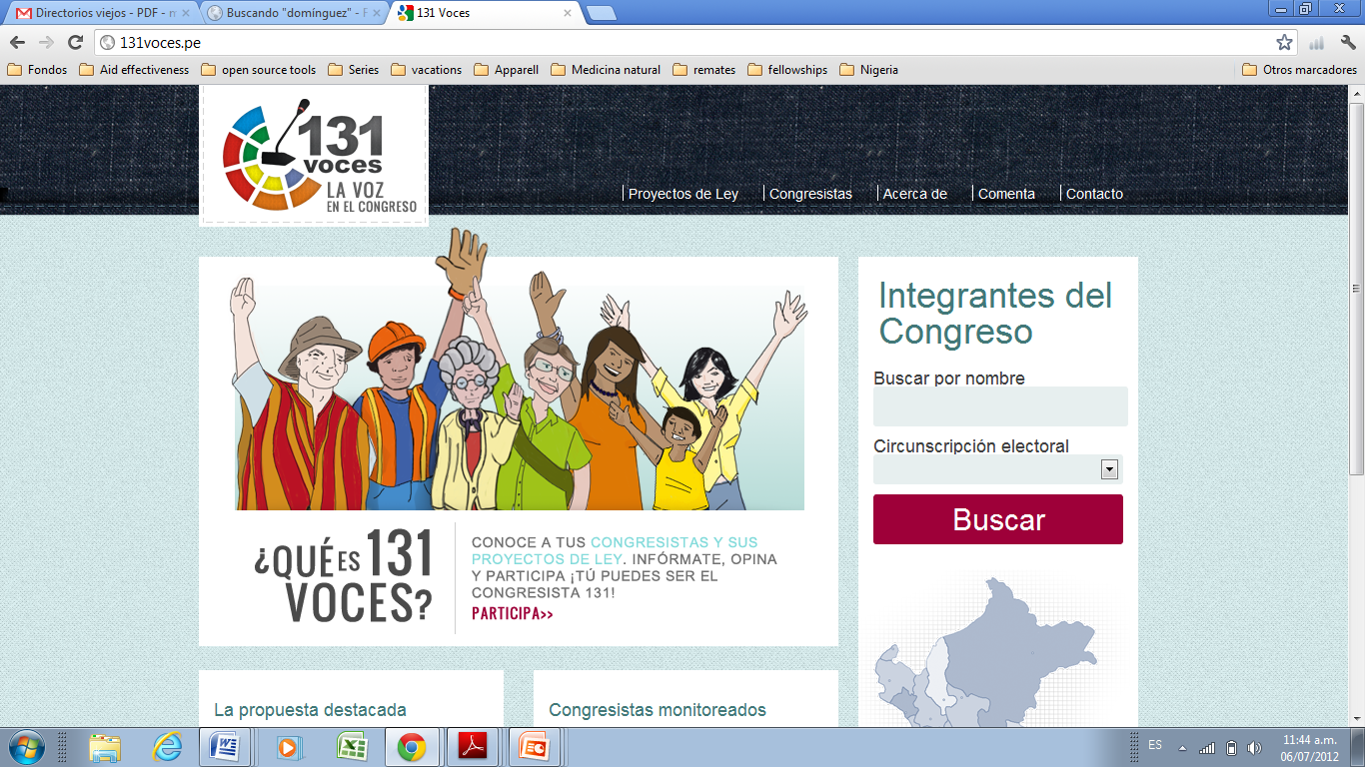
July 6th, Paris, France

Slide 11
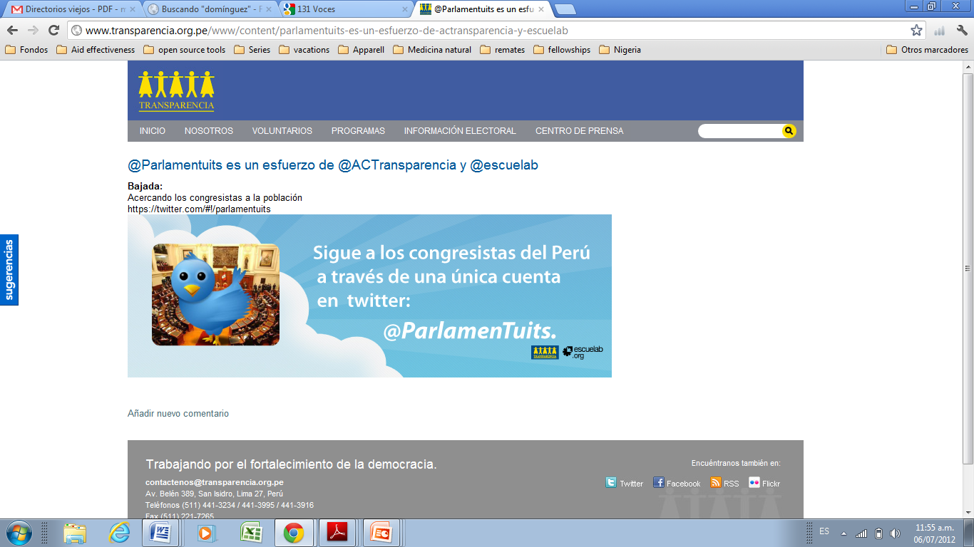
July 6th, Paris, France

Slide 12
Colombia
July 6th, Paris, France

Slide 13
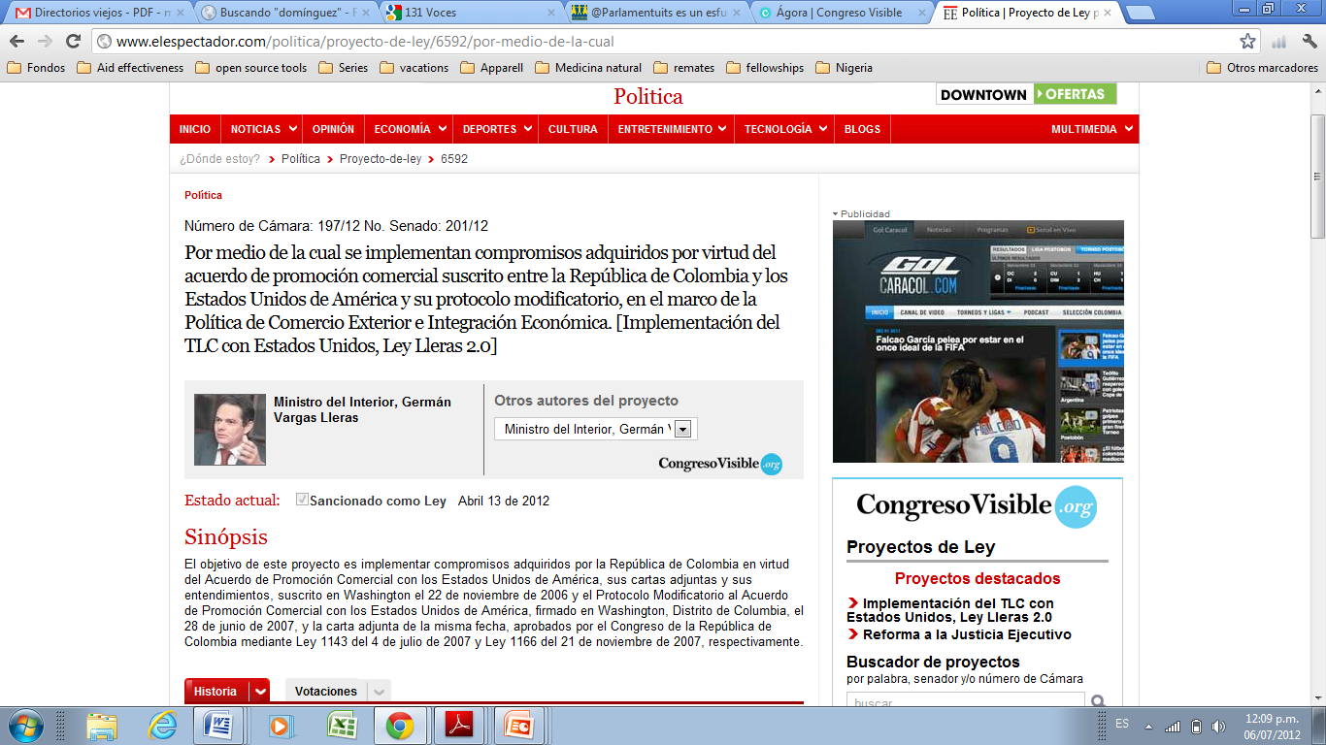
July 6th, Paris, France

Slide 14
Chile
July 6th, Paris, France

Slide 15
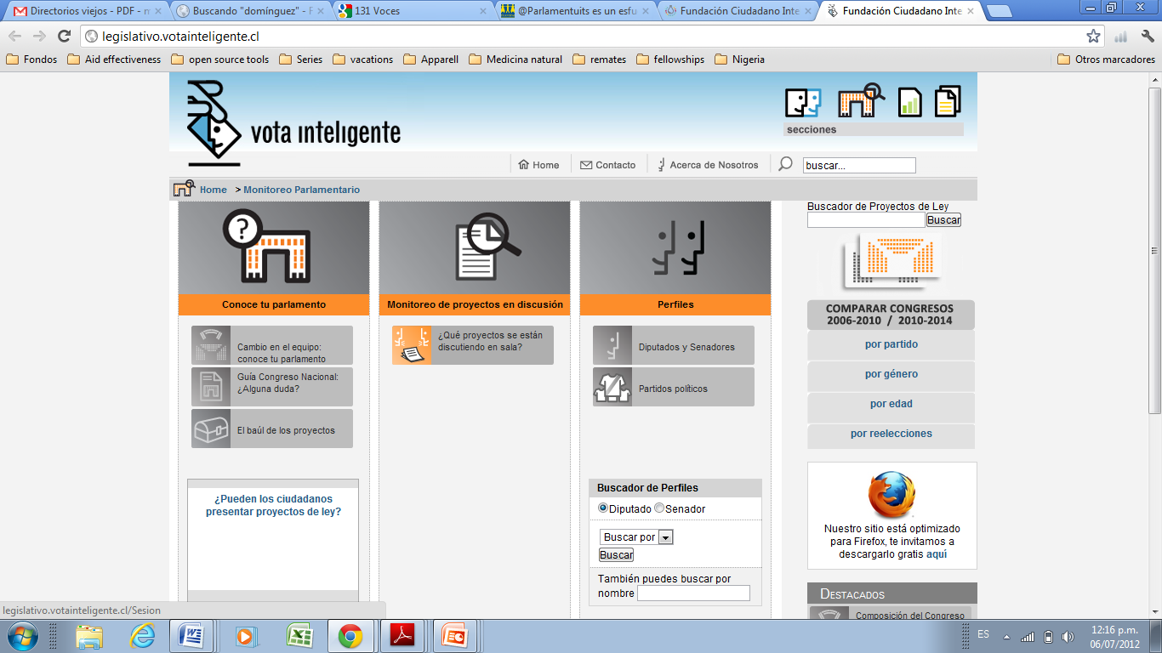
July 6th, Paris, France

Slide 16
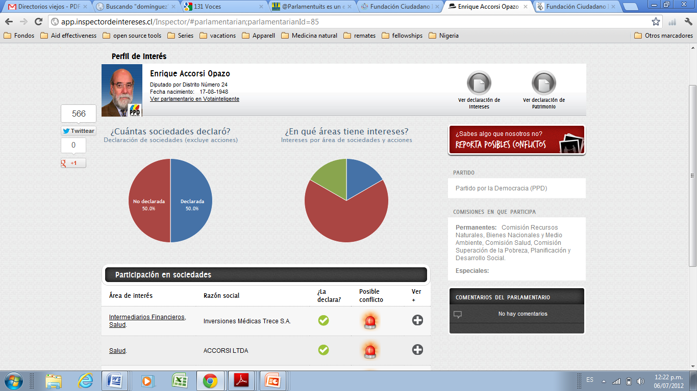
July 6th, Paris, France

