Slide 1
Testing the Limits of WestlawNext Legislative Data
Lee Peoples
Oklahoma City University School of Law

Slide 2
What is WestlawNext

Slide 3
Federal Legislative Data on WLN

Slide 4
Dates are confusing – actually WLN is about 1-2 days behind

Slide 8
WLN Graphical View

Slide 10
Click and get a pop-up document

Slide 12
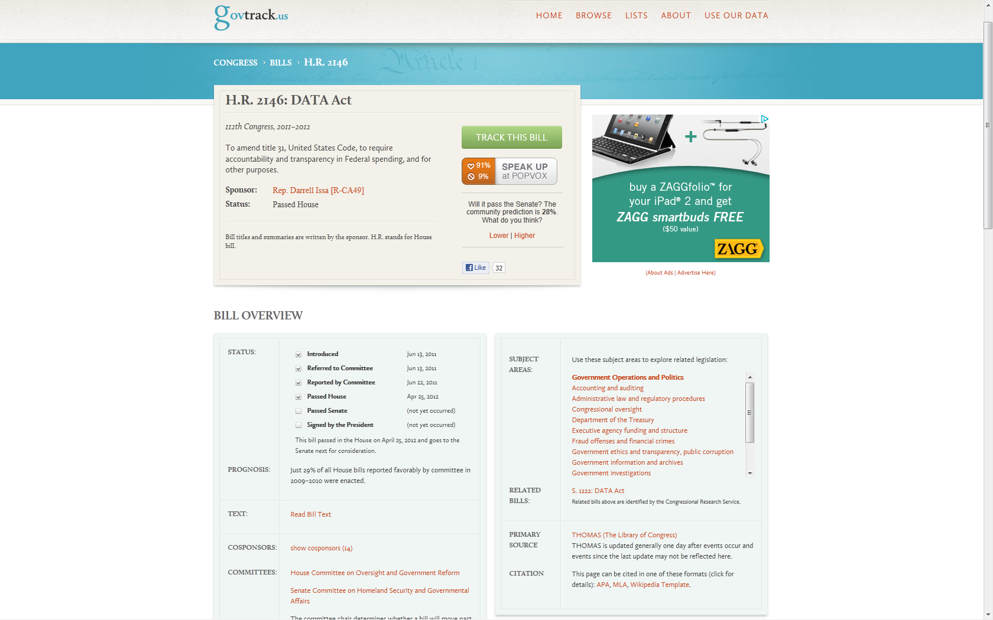

Slide 18
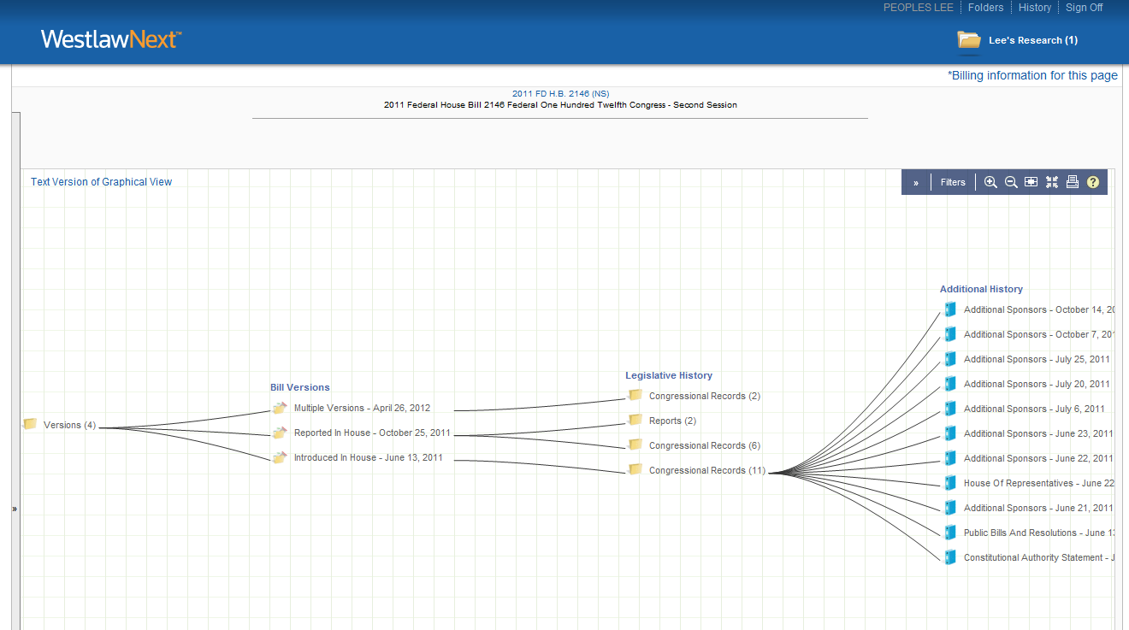
Cost to View Each Document ?

Slide 19
WLN Thomas
21 documents directly linked
$616
6 documents directly linked – others available
$ free

