Slide 1
Measuring Legislative Oversight
Jonathan Bright
jonathan.bright@eui.eu

Slide 2
The potential of parliamentary informatics
‘Open’ data sources present a huge opportunity for political science
Can measure the previously unmeasurable and hence put existing theories about the functioning of parliaments to the test

Slide 3
Measuring Oversight
This project is about measuring one such concept: ‘oversight’
Crucial function of modern parliaments
Defined here as the scrutiny of individual pieces of legislation as they move through the legislative process

Slide 4
Previous measures
Single case studies or reviews of small amounts of legislation
Can’t speak to general trends
Very general measures based on for example the overall time to legislation
Little attention to the nuance of the parliamentary process

Slide 5
Measuring Oversight
Four measures:
Speed of the process both overall and its individual stages
Committee debates
Substantive changes made to legislation
Roll call votes
Question: do bills relating to crime and security receive less scrutiny than other pieces of legislation?
Data based on the UK parliament, 1997-2012
Extracted from:
www.parliament.uk
www.legislation.gov.uk
www.publicwhip.org.uk

Slide 6
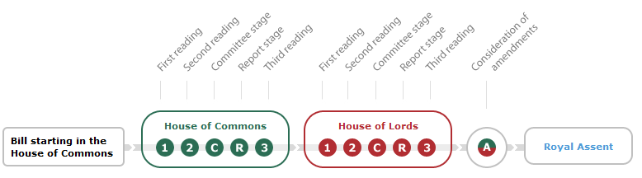
Speed
Average crime and security bill has become law before the average normal bill has passed through its second reading

Slide 7
Committees
Average crime and security bill has more committee sittings
…and these sittings generally last for longer

Slide 8
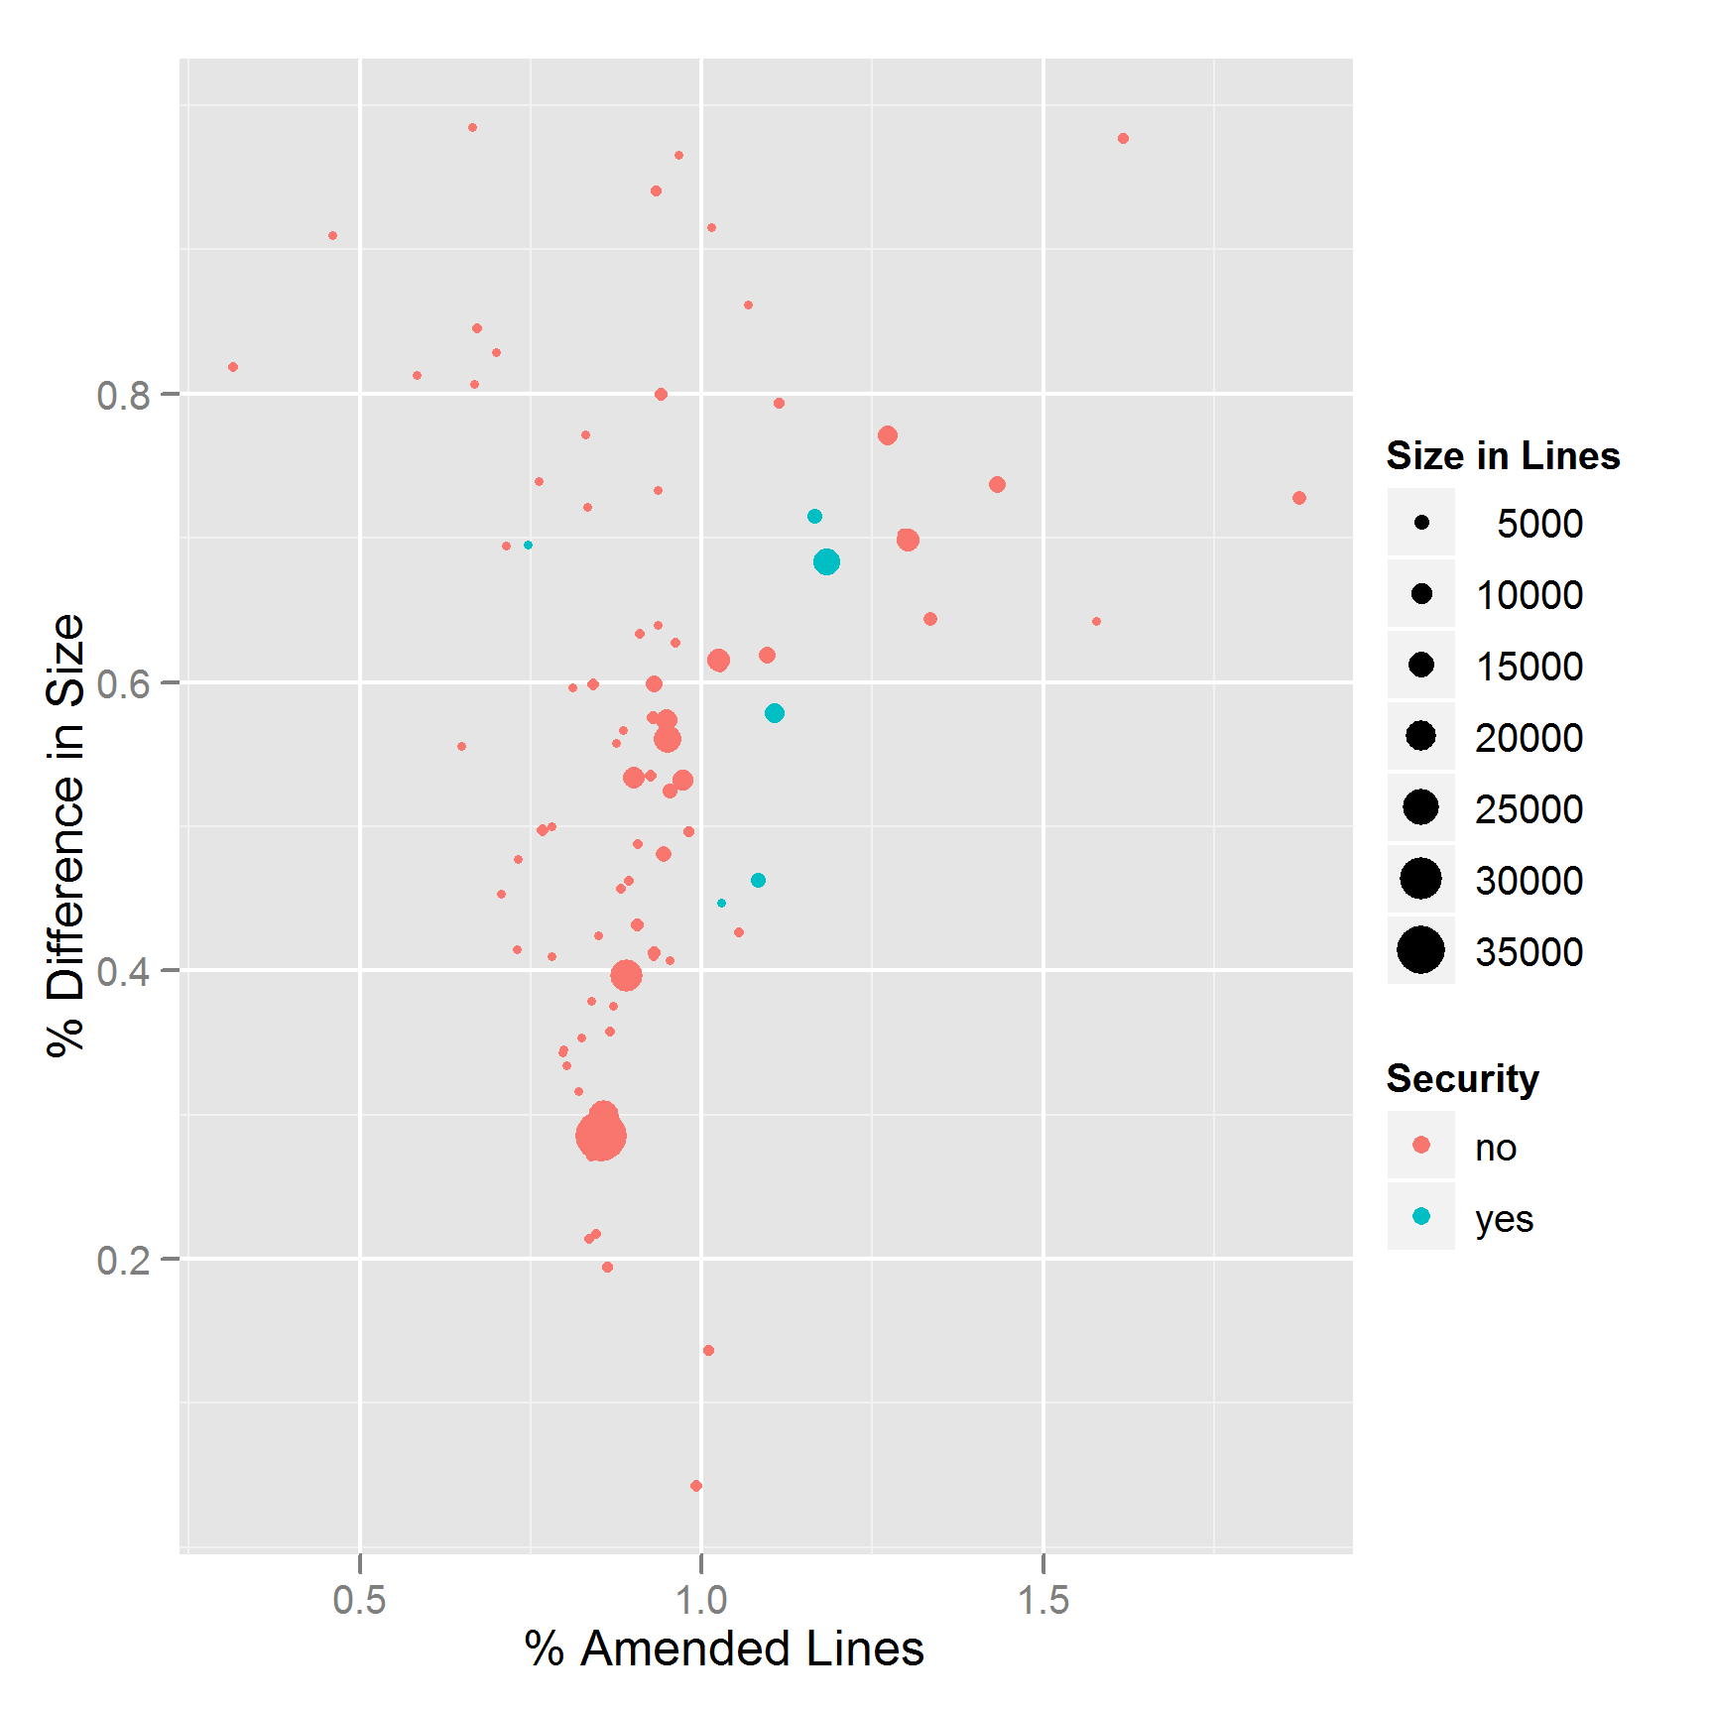
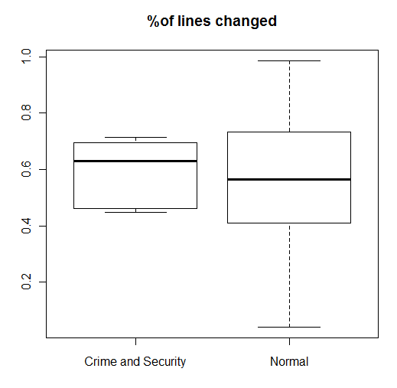
Amendments
No statistical difference between amount of amendments
(python’s difflib used for calculation)

Slide 9
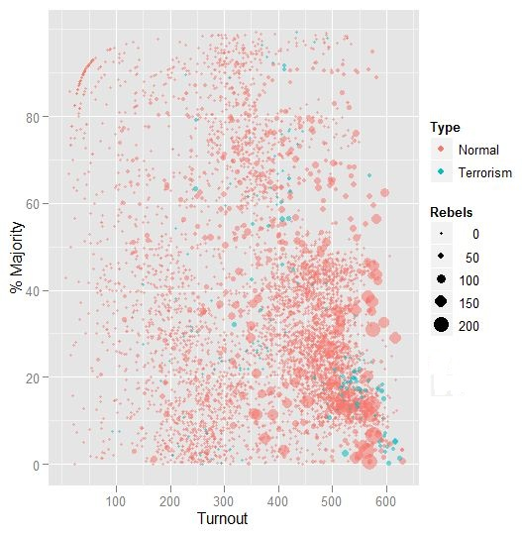
Vote
Largest cluster of crime and security votes in the bottom right hand corner

Slide 10
Conclusions
Crime and security bills have an expedited legislative process
But more legislative activity is packed into this time
A plea to those «opening parliament» – don’t forget about academics!
Bulk download options for data as well as APIs
Standard / easily decodable formats: XML and JSON as well as HTML and PDFs
Sunlight foundation / Theywork for you great examples of this

