Slide 1
Transparency Developments in the U.S. Congress
Daniel Schuman, Policy Counsel
@danielschuman

Slide 2
About Us
www.sunlightfoundation.com
Daniel Schuman

Slide 3
Background on Congress
Largest staff of any legislature – but young and shrinking
Major budget cuts – 11% reduction in House over last 2 years
No central control of information dissemination
Divided implementation of information services
Daniel Schuman

Slide 4
Overview of Progress
House of Representatives has led
Senate has made minimal progress
Congress (esp. support agencies) are slow if not recalcitrant
A few legislative victories
Daniel Schuman

Slide 5
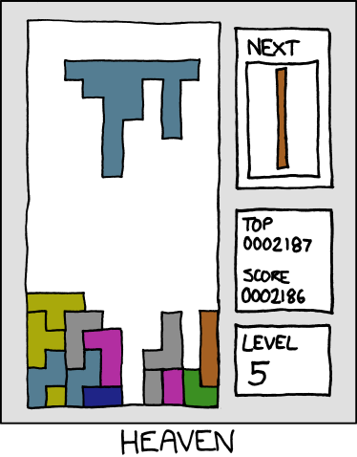
House of Representatives
Daniel Schuman

Slide 6
House of Representatives
Current Leadership (2011-2012)
Updating House Rules
72-hour rule
Webcasting hearings
Bulk access
Leadership statement
Docs.house.gov portal
3 Conferences
Madison project (Issa)
Daniel Schuman

Slide 7
House of Representatives
Prior Leadership (2007-2010)
Creation of “Office of Congressional Ethics”
Publication of Statement of Disbursements
Twitter / YouTube
Earlier reforms w/r/t 72-hour rule
Earmark transparency
Open House Project???
Daniel Schuman

Slide 8
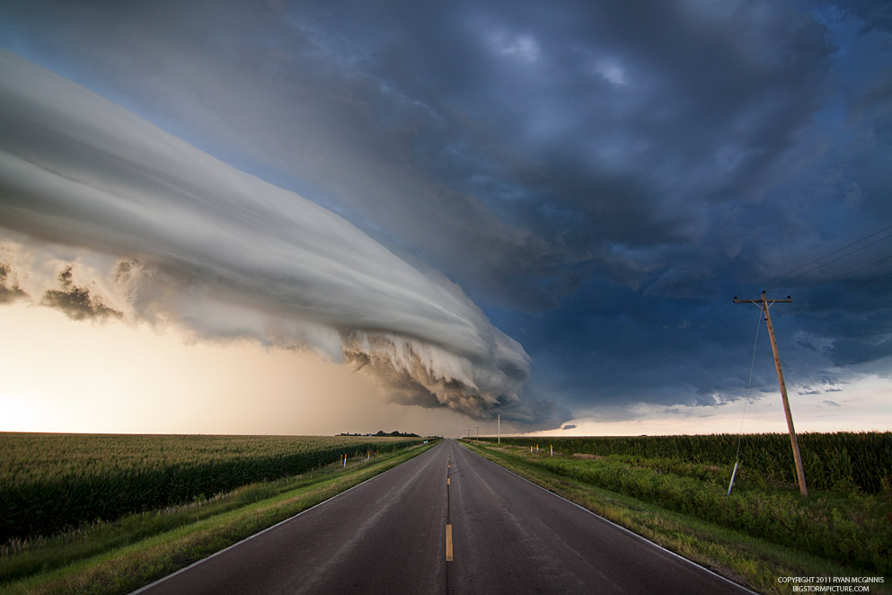
Senate
Daniel Schuman

Slide 9
Senate
Statement of Disbursements (much later)
Votes in XML
Improving committee / member websites
Twitter/ YouTube
#FAIL: Electronic Filing
Daniel Schuman

Slide 10
Congress’s Legislative Activities
Daniel Schuman

Slide 11
Congress’s Legislative Activities
Enacted
Improved lobbying reporting (plus database)
Financial transaction reporting (STOCK Act)
Recovery.gov // Dodd-Frank // TARP
E-Gov Fund (Data.gov, etc.)
Introduced
DATA Act (spending transparency)
Public Online Information Act (standards + online pub)
DISCLOSE Act (campaign finance)
Congressional Research Reports // ACMRA
Daniel Schuman

Slide 12
Congress’s Non-Legislative Activities
Bulk Access to Legislative Information
Examples: THOMAS // CRS Reports // Constitution Annotated // Statutes at Large
Daniel Schuman

Slide 13
What’s Next?
Inside the institution
Bulk access (still!)
Official electronic copies of docs + online access
Evaluating progress and consolidating gains
Lawmaking
Lobbying disclosure legislation
Campaign finance disclosure legislation
Daniel Schuman

Slide 14
Thanks
@danielschuman
Daniel Schuman

