Slide 1
Declaration on Parliamentary Openness
What is it?
Document drafted by NDI with the help of Sunlight Foundation and the Latin American Network for Legislative Transparency during April and May 2012 and presented in Washington, DC in May.

Slide 2
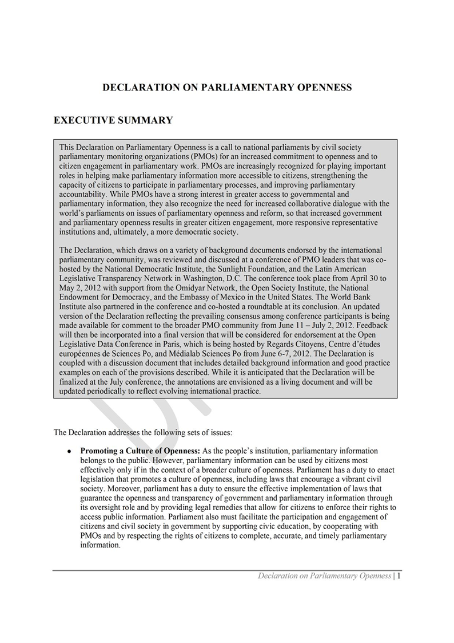

Slide 3
Declaration on Parliamentary Openness
What’s in it?
1. Preamble
2. Promoting a Culture of Openness
3. Making Parliamentary Information Transparent
4. Making Parliamentary Information Easily Accesible
5. Enabling Electronic Access and Analysis of Parliamentary Information

Slide 4
Declaration on Parliamentary Openness
What has been done so far?
First draft was introduced to PMOs in Washington,DC, May 2012;
Organizations divided in groups according to their regional areas commentes each of the sections of the Declaration;
After Washington those comments were sistematized and many were incorporated to the doc;
NDI worked on the background notes
More people were invited to join in the discussion through a google group;
Piece translated into Spanish.

Slide 5
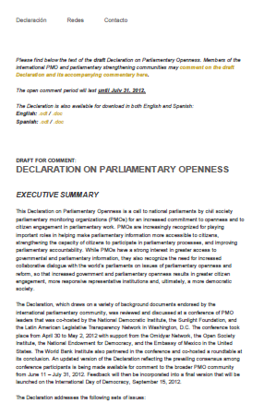
OpeningParliament.org

Slide 6
Declaration on Parliamentary Openness
PublicMARKUP.org

Slide 7
Declaration on Parliamentary Openness
What’s next?
1. Deadline for comments JULY 31st.
2. Include a broader community of activists
3. How about reformist parliamentariand?
4. How could each of us use this in our particular countries?
5. Should we think of more specific declarations country by country or region by region?
6. Can we move forward and think of a tool to monitor our Parliaments?

