Slide 1
Tracking the legislative process in Romanian Chamber of Deputies
Mihail Chiru
Median Research Centre Bucharest &
Central European University Budapest
Time has come for law tracking
Paris, May 28th 2014

Slide 2
The Romanian Context and our PMT
Very low level of trust in Parliament.
High frequency of party switching.
Low programmatic responsiveness.
Three dimensions of interest: individual MPs, parliamentary parties and public policy domains
Beta version at: website.firenze.grep.ro
Launch scheduled for mid June 2014

Slide 3
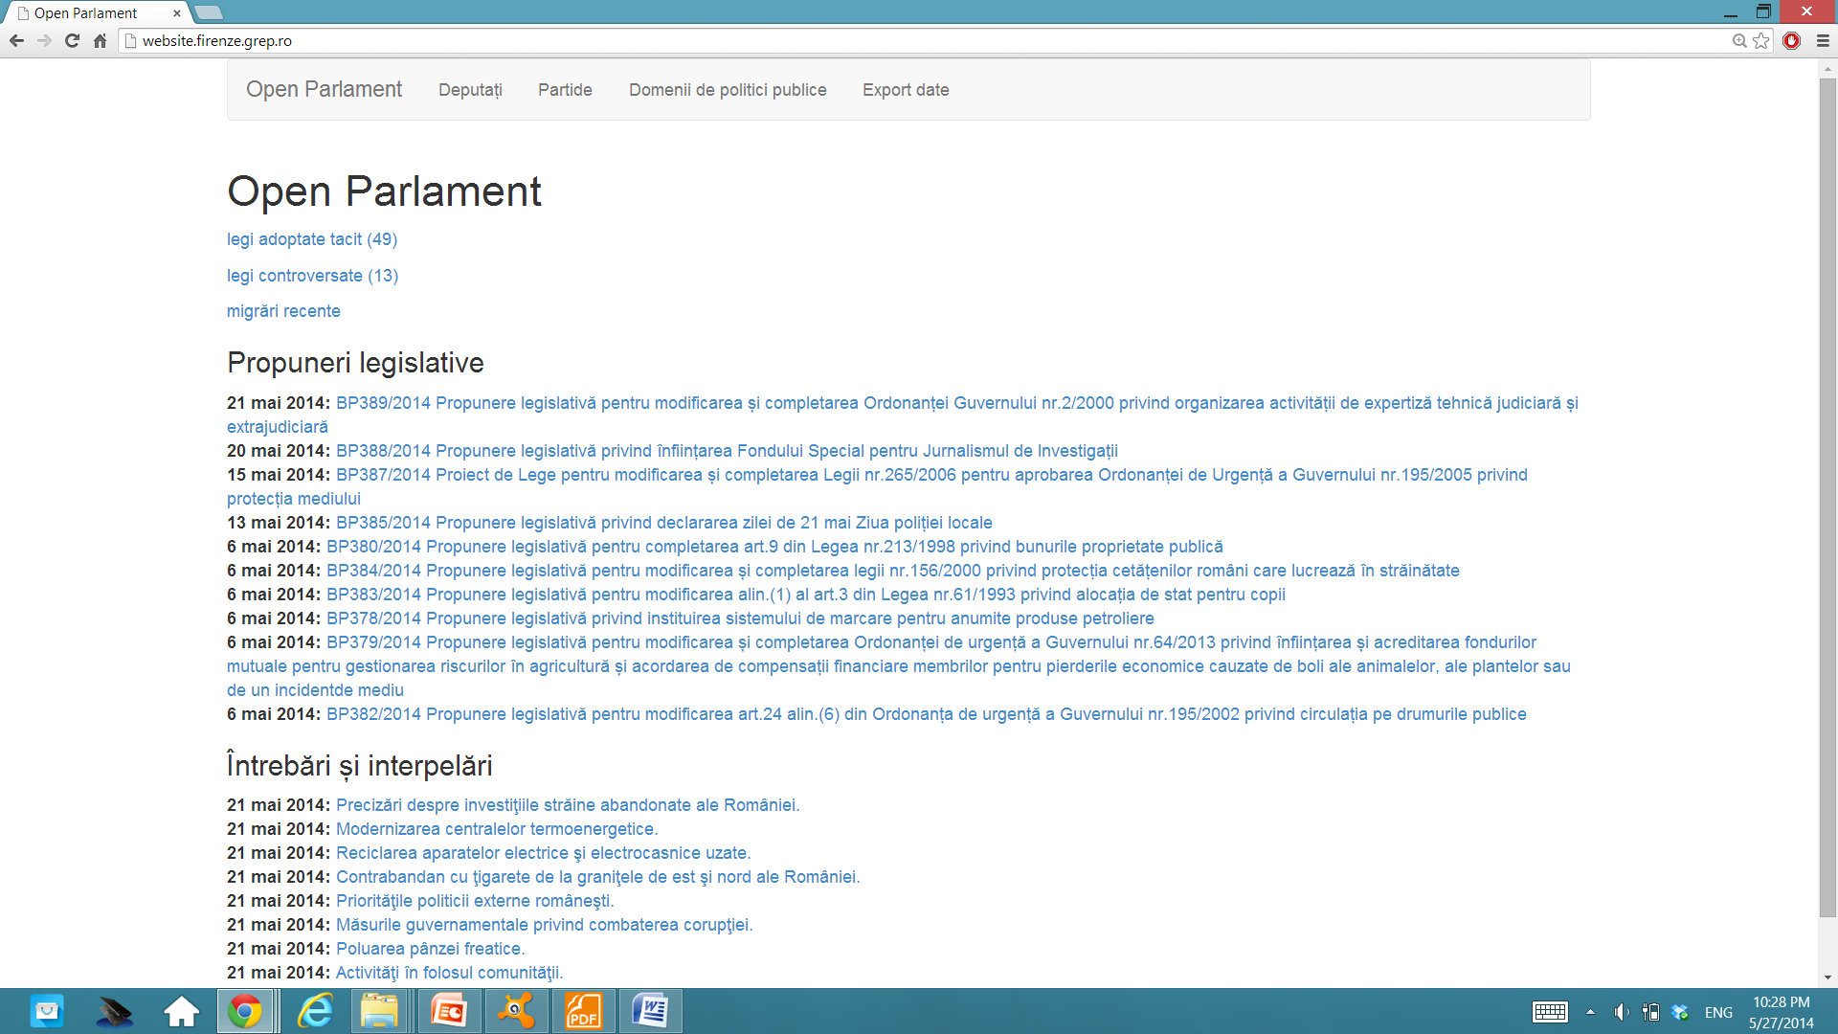

Slide 4
What do we do in terms of law tracking?
Allow users to follow the legislative process on each bill
Track bills by public policy domain
Track bills adopted without debate and/or vote in the first Chamber
Track controversial bills and the vote on them
Track the bills used for local interest representation

Slide 5
Following the legislative process of each bill
The application shows the stage the bill has reached in the legislative process [two readings – one chamber reflects the other decides, both debate and vote on the bill].
It presents all documents (amendments, committee reports, etc.) that the bill has received.
We are still looking for ideas to visualizing this type of data

Slide 6
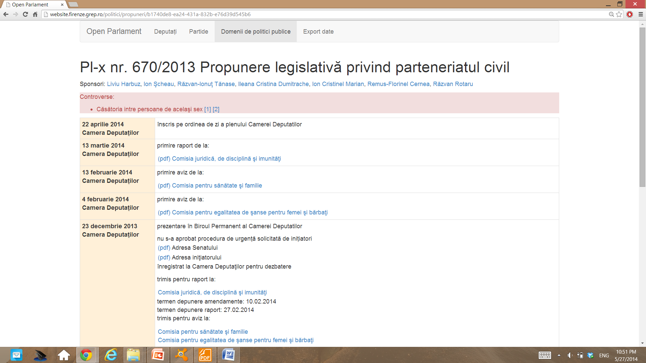

Slide 7
Tracking bills by public policy domain
Using information about the first committee which reads the bill we assign it to one of the 15 major public policy domains.
Specialized NGOs or ordinary citizens can keep track of the latest developments in that policy area.
We show which parties and MPs are the most active in the various policy areas.

Slide 8
Ethical challenges of tracking bills… passed without debate or vote in the first Chamber
If a bill is not debated or voted upon in 45 days it is considered adopted and sent to the other Chamber, which will decide on it.
The goal – to make the legislative process more predictable and to avoid deadlocks/ delays.
Reality: bills passed without the MPs knowing their content
Fewer chances for MPs or civil society actors to influence the content and the fate of the bill
Media picks up the most outrageous bills passed in this way – legitimacy loss for the whole Parliament

Slide 9
Tracking bills adopted without debate and/ or voting

Slide 10
Tracking controversial bills and show how each MP has voted on them
List of controversial bills (based on reports from media, civil society experts, own judgment, )
Single out the votes on these bills and explain what ‘for’ and ‘against’ meant substantively.

Slide 11
Tracking local interest representation through bills
Fuzzy matching the text of the bill and geographical names from the county of each MP; score based on the number of associations found.
Particularly effective for parliamentary questions, we still face technical problems for the bills.

Slide 12
Parliamentary questions on local/ constituency issues

